Slide 1
Spying On Your Application
How To Be a Super Sleuth Tester

Slide 2

New slides, who dis?
Hilary Weaver-Robb
Software Quality Architect
Detroit, MI, USA

Slide 3
Objective
Introduce Browser Developer Tools
Why they are helpful
How to find them in various browsers

Slide 4
Objective BORING! 😴😴😴
Introduce Browser Developer Tools
Why they are helpful
How to find them in various browsers

Slide 5
The Brief
Something’s missing…
This button is useless!
We’ve got mobile users now, oh no!

Slide 6
But First!
Tools of the Trade

Slide 7

Lots of other cool stuff!
Elements
Sources
Console
https://pngtree.com/freepng/detective-tools_3251231.html
Network

Slide 8
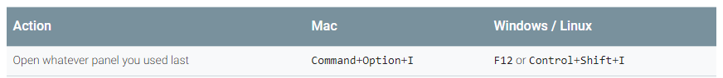
Dev Tools

Slide 9
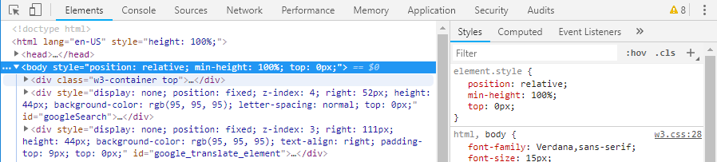



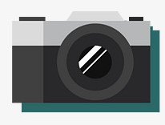
Dev Tools
Elements
Console
Sources
Network

Slide 10
The Case of The Missing Dog
When the UI isn’t giving us any clues, we need to head to Dev Tools!

Slide 11

Case File
Cooper is missing!
What could be the culprit?
New image slider was implemented
JavaScript
Images exist on the server

Slide 12
Spy Tools – Console
JavaScript errors
Some network errors

Slide 13
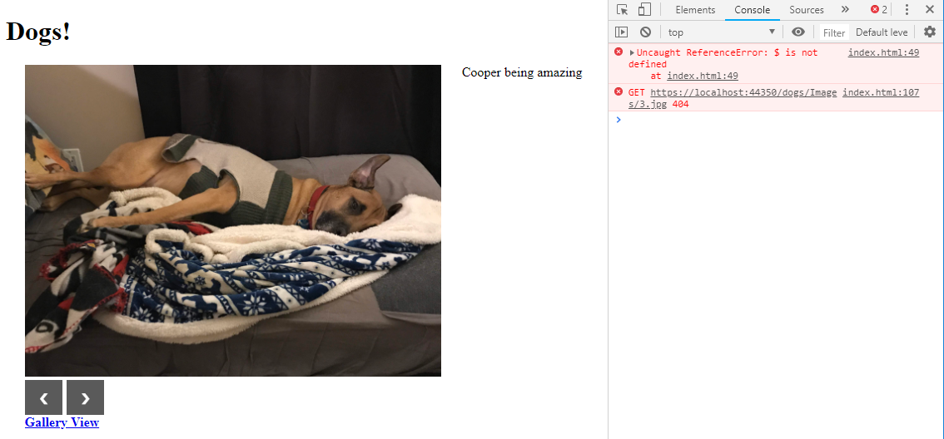
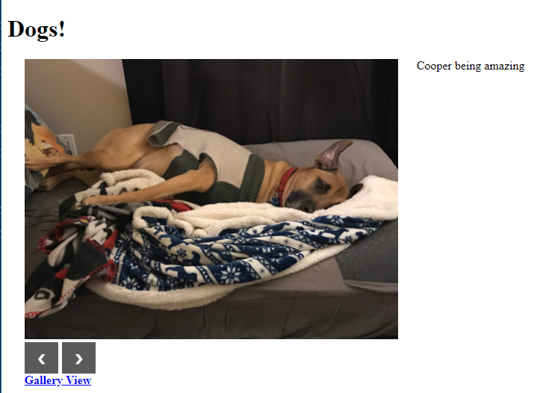
Spy Tools – Console

Slide 14
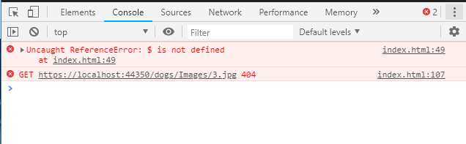
Spy Tools – Console

Slide 15
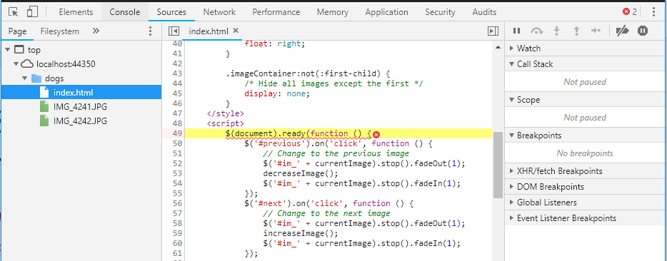
Spy Tools – Console -> Sources

Slide 16
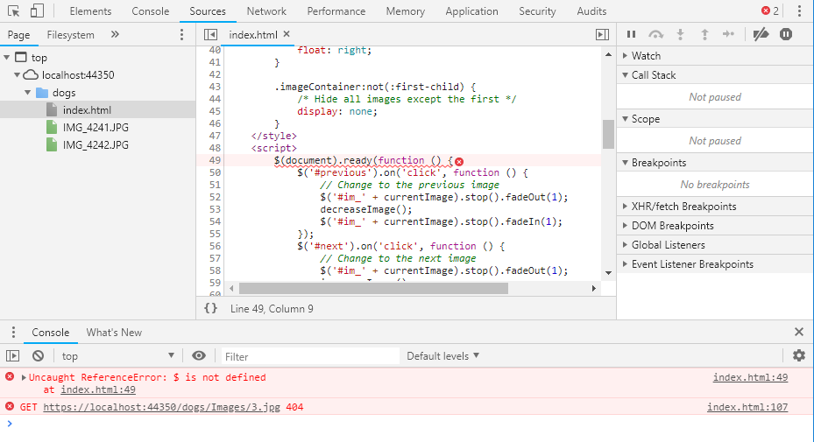
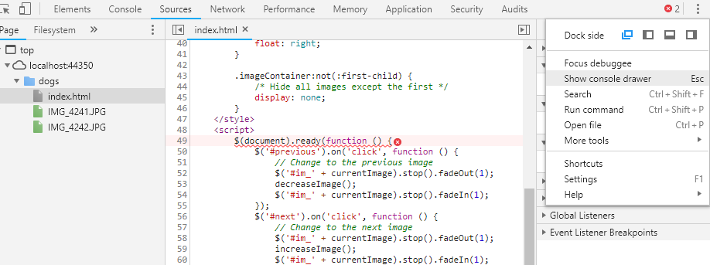
Spy Tools – Console -> Sources

Slide 17
Spy Tools – Network
Calls the application makes
To itself
To other services and applications

Slide 18
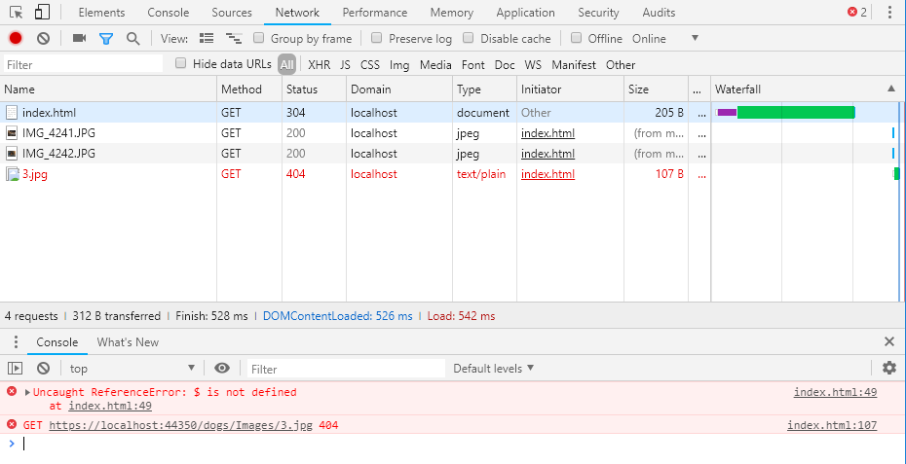
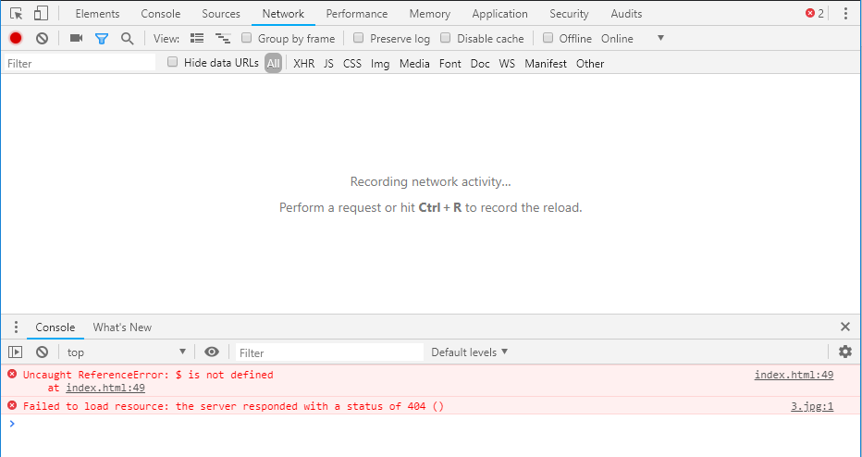
Spy Tools – Network

Slide 19
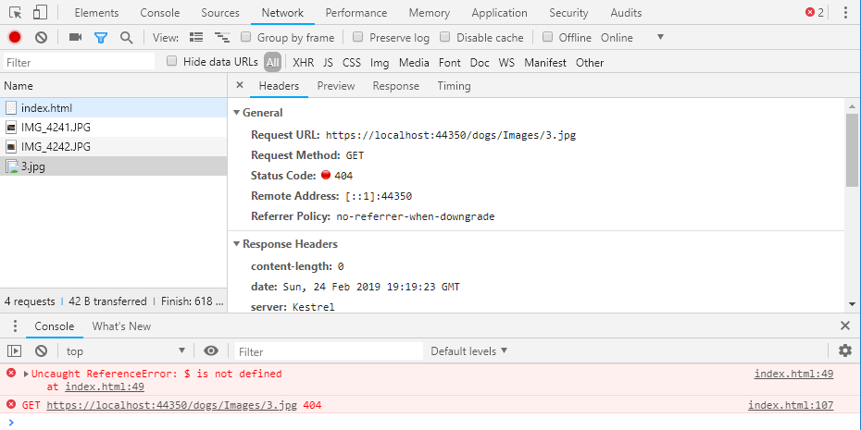
Spy Tools – Network

Slide 20
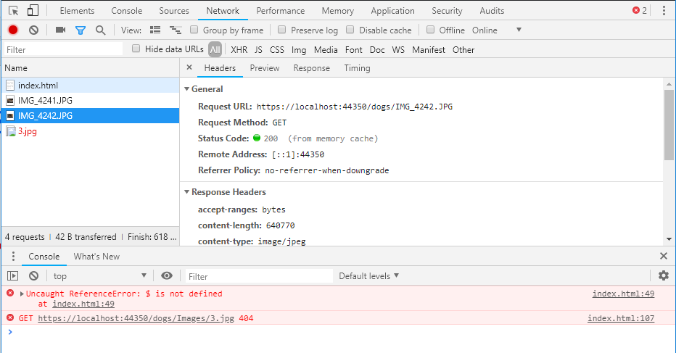
Spy Tools – Network

Slide 21
Spy Tools – Network

Slide 22
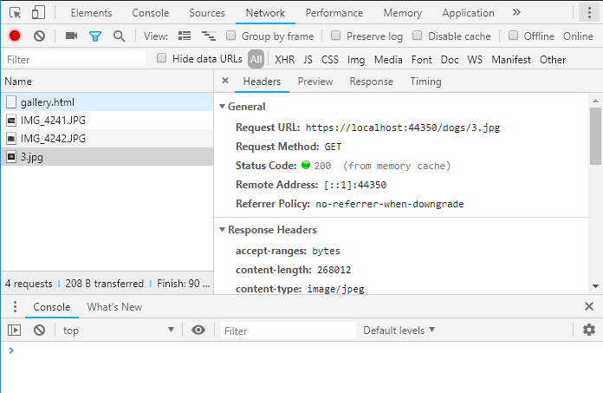
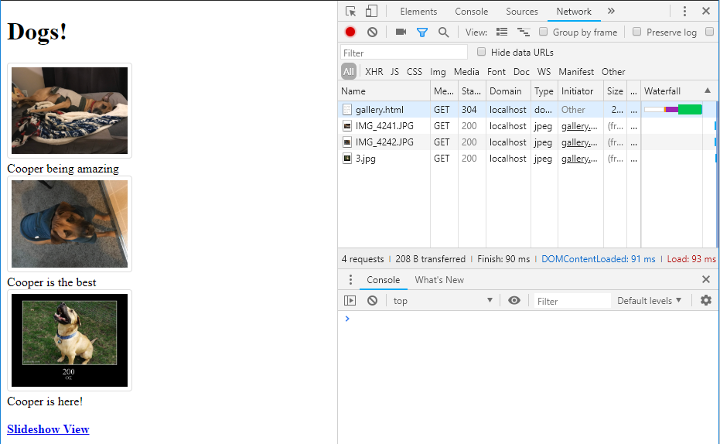
Spy Tools – Network

Slide 23
The Case of The Useless Button
When buttons aren’t working, Dev Tools has the answers!

Slide 24
Case File
Slideshow button isn’t working ☹
What could be the culprit?
JavaScript
Button isn’t linked properly to the JavaScript?

Slide 25
Spy Tools – Elements
Inspect and edit HTML and CSS
View how JavaScript affects the DOM

Slide 26
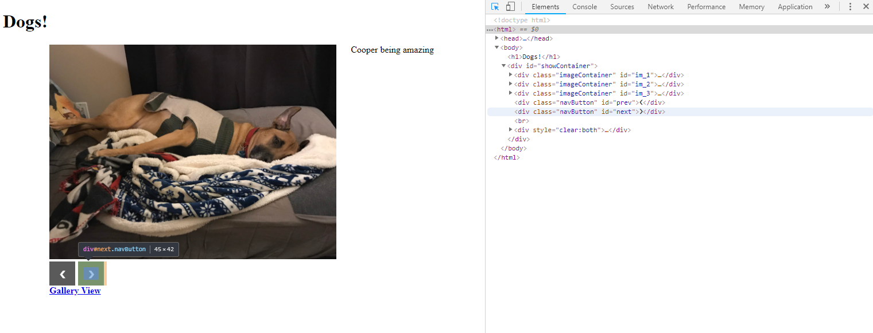
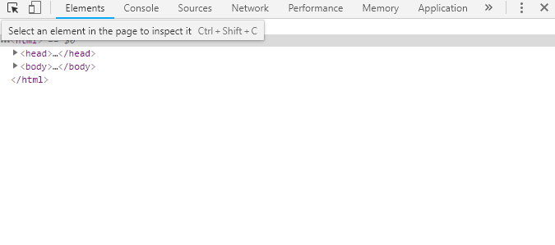
Spy Tools – Elements

Slide 27
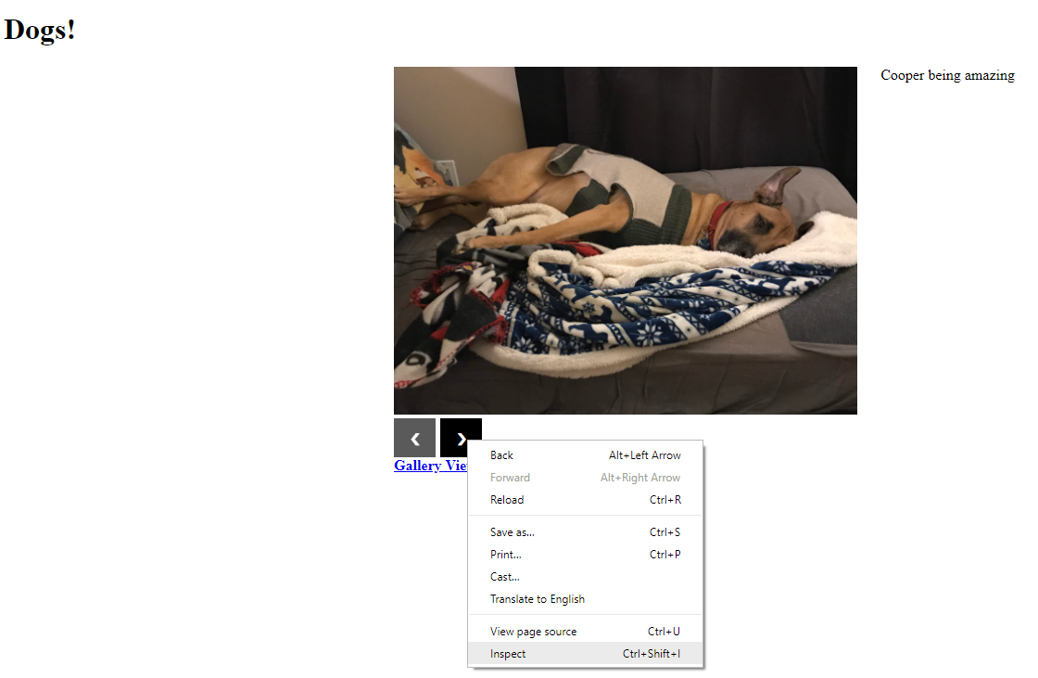
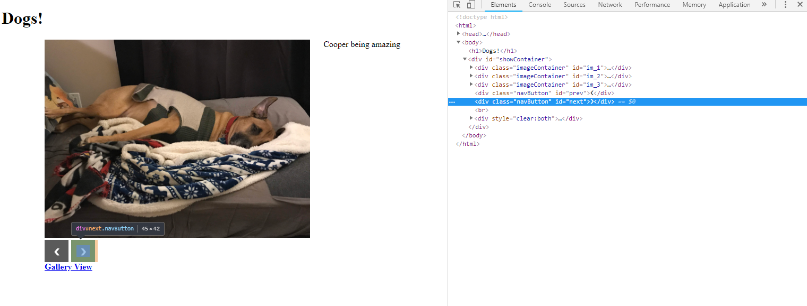
Spy Tools – Elements

Slide 28
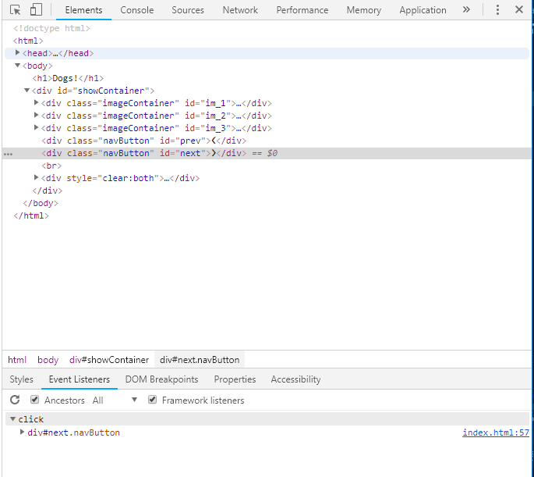
Spy Tools – Elements

Slide 29
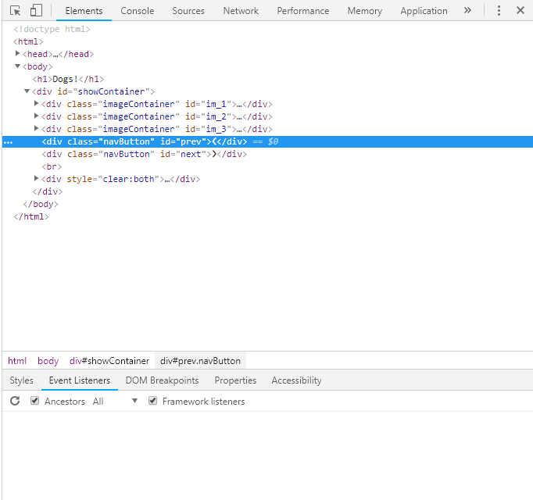
Spy Tools – Elements

Slide 30
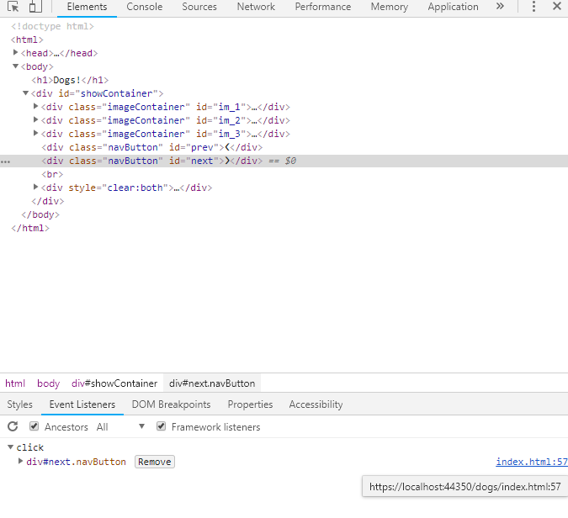
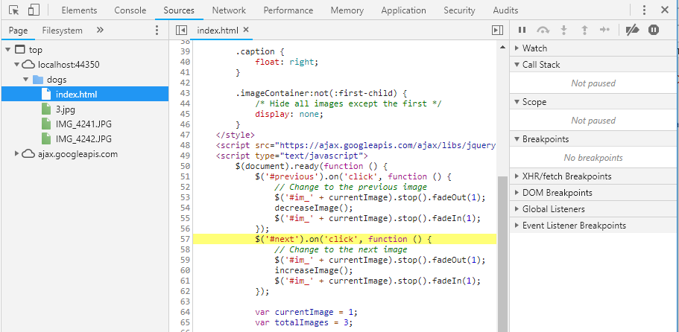
Spy Tools – Elements -> Sources

Slide 31
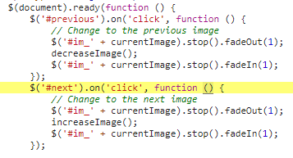
Spy Tools – Sources

Slide 32
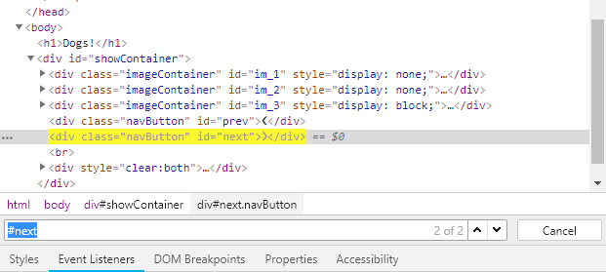
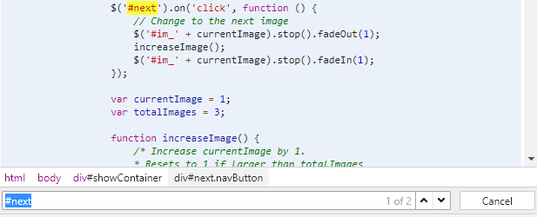
Spy Tools – Elements

Slide 33
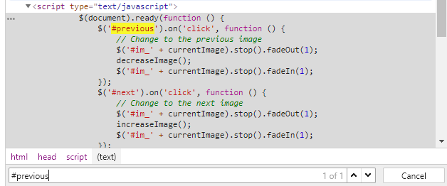
Spy Tools – Elements

Slide 34
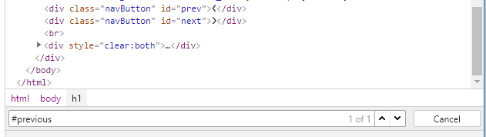
Spy Tools – Elements

Slide 35
The Case of The Shrinking Screens
When our users complain about our site on mobile, Dev Tools can help us repro!

Slide 36
Case File
Mobile users can’t get back to Gallery View
What could be the culprit?
Missing link?
Not responsive?

Slide 37

Spy Tools – Device Toolbar
View your site in pre-defined sizes
Device emulators

Slide 38
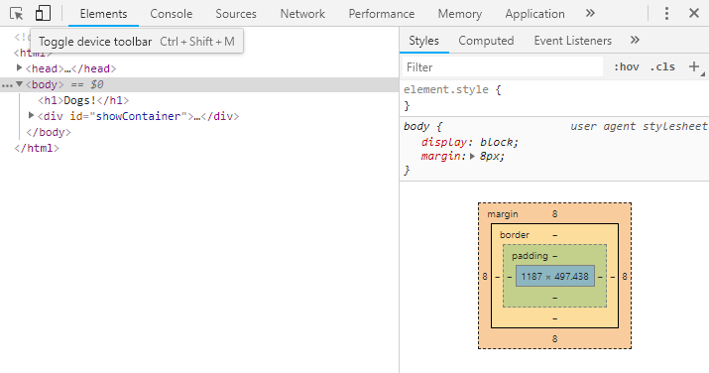
Spy Tools – Device Toolbar

Slide 39
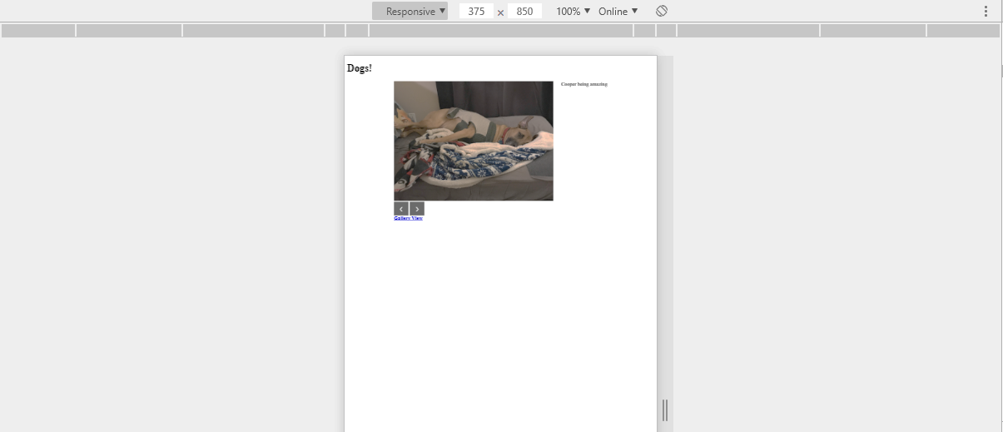
Spy Tools – Device Toolbar

Slide 40
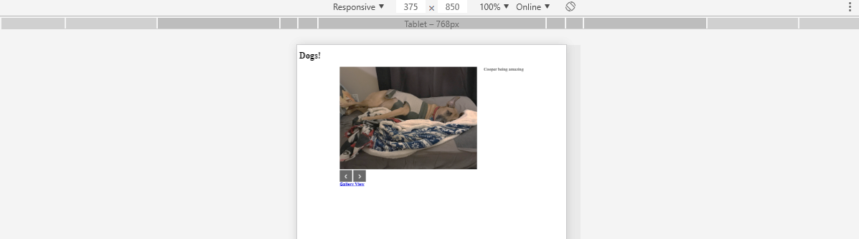
Spy Tools – Device Toolbar

Slide 41
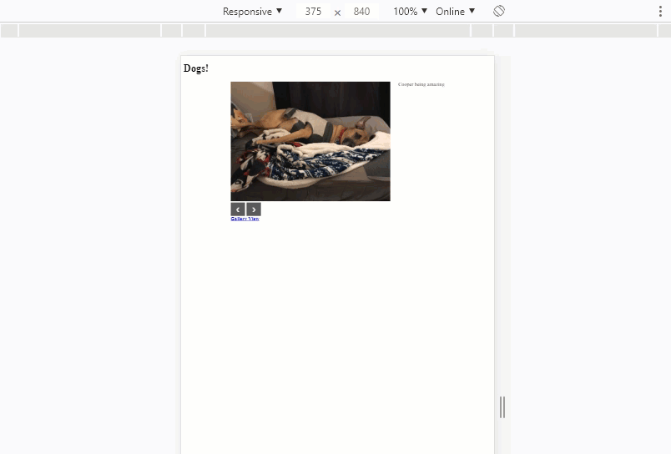
Spy Tools – Device Toolbar

Slide 42
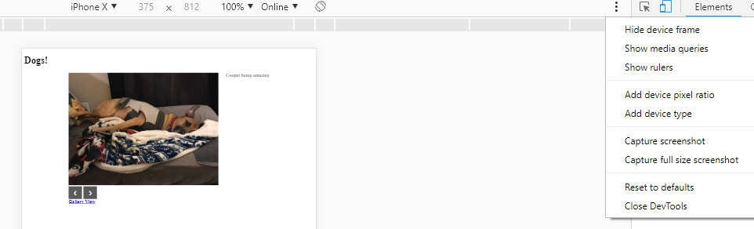
Spy Tools – Device Toolbar

Slide 43
Spy Tools – Audit
Performance
Accessibility (a11y)
User experience (UX)

Slide 44
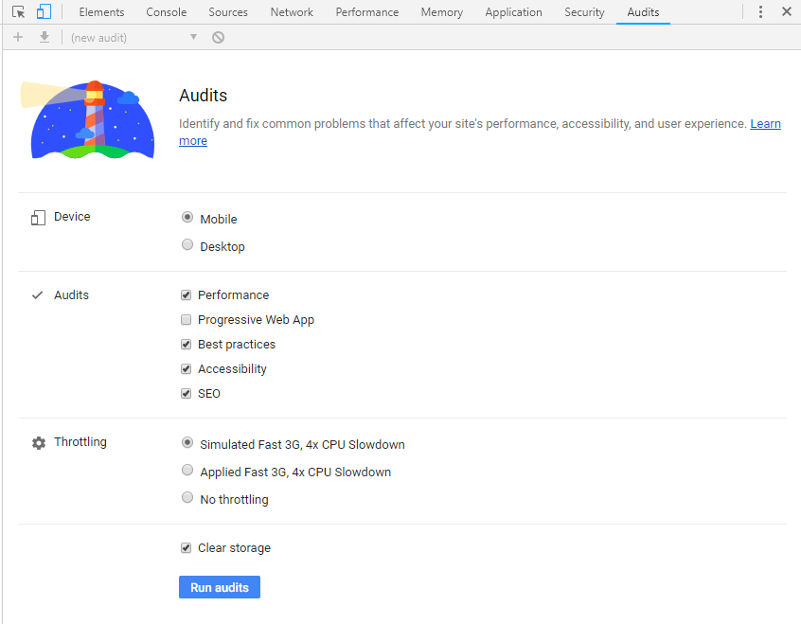
Spy Tools – Audit

Slide 45
Spy Tools – Audit

Slide 46
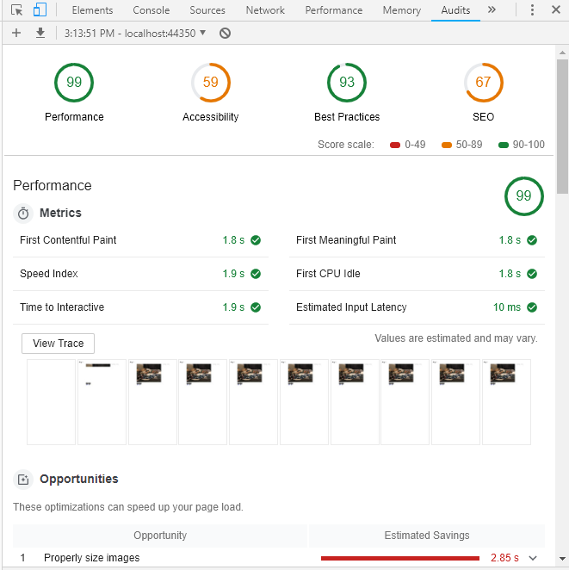
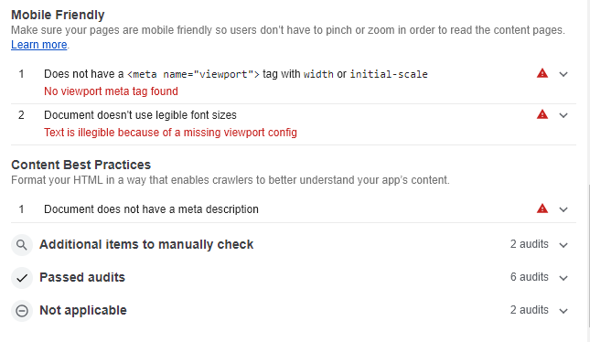
Spy Tools – Audit

Slide 47
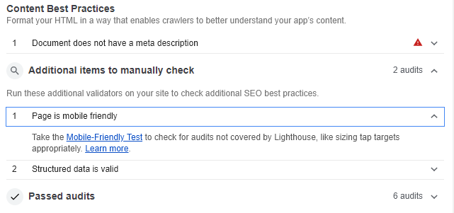
Spy Tools – Audit

Slide 48
Other Spy Tools
Dev tools is super cool

Slide 49
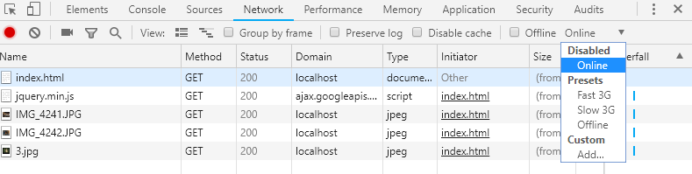
Spy Tools – Other Tools

Slide 50
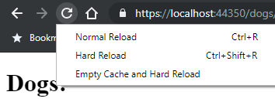
Spy Tools – Other Tools

Slide 51
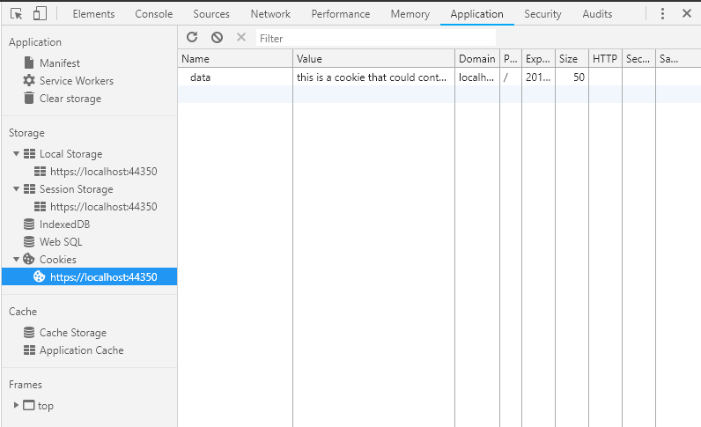
Spy Tools – Other Tools

Slide 52
And so much more!

Slide 53
Debrief
JavaScript errors
Console
Sources
404 errors (missing files)
Network
Nonfunctional buttons
Elements
Sources
Mobile capability
Device Toolbar
Audits

Slide 54


Resources
@ChromeDevTools
@FirefoxDevTools
@11vlr
Devtools.chrome.com
Anti-code.com/devtools-cheatsheet
@coopamoose

Slide 55
Questions?

